Slide 1

Heart Disease Prediction Using Logistic Regression
Predicting heart disease likelihood using clinical attributes
Presented by: Anushka Sinha
Institution: Techno India University

Slide 2




What is Heart Disease?
Coronary artery disease is a major global health concern, where blood vessels supplying the heart become narrowed or blocked. Early and accurate prediction is crucial for timely intervention and improving patient outcomes, directly impacting treatment strategies and quality of life.
Chest Pain
Breathlessness
Fatigue

Slide 3
Dataset Overview: UCI Heart Disease
Our predictive model is built upon the widely recognized UCI Heart Disease Dataset, a collection of comprehensive patient data designed for machine learning research. This dataset includes a rich set of clinical attributes that are vital for assessing cardiac health.
Age: Patient's age in years
Thalach: Maximum heart rate achieved
Sex: (1 = male; 0 = female)
Exang: Exercise-induced angina
CP: Chest pain type (e.g., typical angina, atypical angina)
Oldpeak: ST depression induced by exercise
Slope: Slope of the peak exercise ST segment
Trestbps: Resting blood pressure
CA: Number of major vessels colored by fluoroscopy
Chol: Serum cholesterol level
Thal: Thallium stress test result (e.g., normal, fixed defect)
FBS: Fasting blood sugar (> 120 mg/dl)
Restecg: Resting electrocardiographic results
Target: (1 = heart disease; 0 = no heart disease)

Slide 4







Machine Learning Workflow
Our approach to predicting heart disease follows a structured machine learning pipeline, ensuring robust data processing
and reliable model development.
Load Dataset
Handle Missing Values
Encode Categorical Columns
Scale Numerical Features
Train Logistic Regression
Evaluate Model
Predict New Patient

Slide 5


Preprocessing: Encoding & Scaling
Effective data preprocessing is fundamental to building an accurate and robust predictive model. These steps transform raw data into a format suitable for machine learning algorithms, enhancing model performance and interpretability.
Encoding for Categorical Features
Scaling for Numerical Features
Categorical variables, such as chest pain type or thallium stress test results, are converted into numerical representations using techniques like Label Encoding or One-Hot Encoding. This allows the model to process non-numeric data.
Numerical features, like age or cholesterol levels, are standardized using StandardScaler. This process transforms data to have a mean of 0 and a standard deviation of 1, preventing features with larger scales from dominating the model.

Slide 6

Model: Logistic Regression
Logistic Regression is a powerful statistical model chosen for its simplicity, interpretability, and effectiveness in binary classification tasks. It directly models the probability of a binary outcome, making it ideal for predicting the presence or absence of heart disease.
Why Chosen: Simple, interpretable, and effective for binary classification.
Probability Output: Provides a probability score (between 0 and 1) indicating the likelihood of heart disease.
Threshold Decision: A predefined threshold (e.g., 0.5) converts probabilities into a definitive prediction (disease/no disease).

Slide 7





Model Evaluation Metrics
Evaluating our model's performance is critical to ensure its reliability and clinical utility. We use a suite of metrics to comprehensively assess its ability to predict heart disease.
Accuracy
Precision
Recall (Sensitivity)
Overall correctness of predictions (TP + TN) / Total
Proportion of true positive predictions among all positive predictions.
Crucial for medical diagnosis: identifies proportion of actual positive cases correctly identified.
F1-Score
ROC-AUC
Harmonic mean of precision and recall, balancing both metrics.
Measures the model's ability to distinguish between classes across various thresholds.

Slide 8
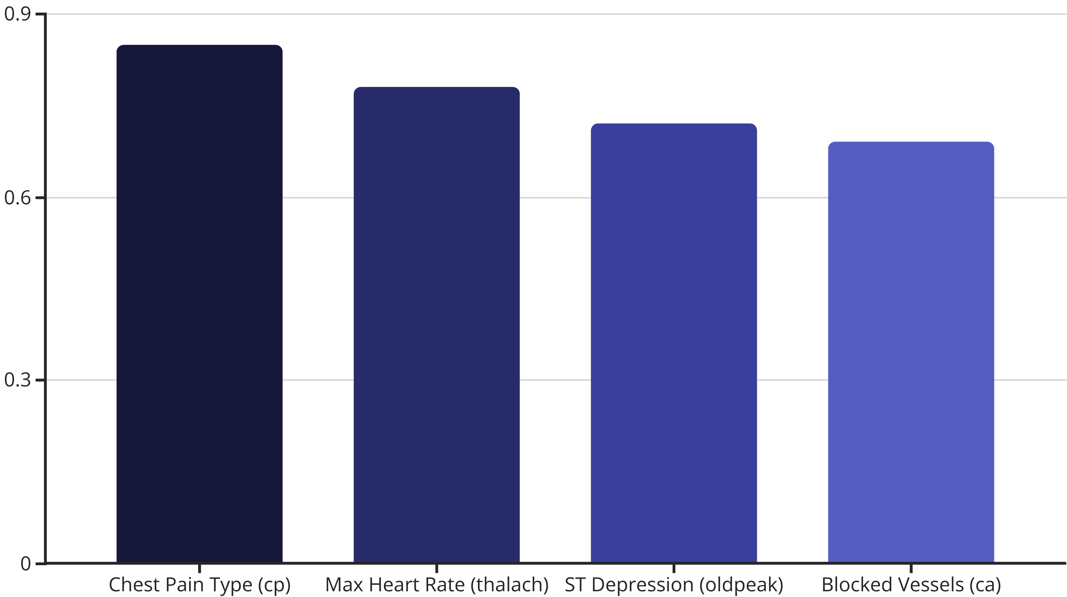
Important Features (Top Contributors)
Understanding which features contribute most significantly to the prediction enhances model interpretability and provides
valuable insights into clinical indicators of heart disease.

Slide 9


Prediction Output Example
Here’s how the logistic regression model provides a quantifiable probability of heart disease for a hypothetical patient, translating complex data into an actionable clinical insight.
Sample Patient Input
Age: 58
Model Prediction
CP Type: Atypical Angina
Resting BP: 140 mmHg
Probability = 72%
Cholesterol: 250 mg/dL
Oldpeak: 2.0
...
Interpretation: High likelihood of heart disease, suggesting further clinical investigation is warranted.

Slide 10

Conclusion & Future Scope
Logistic Regression proves to be a valuable tool for early heart disease prediction, offering interpretable results that can aid clinicians. The future holds exciting possibilities for enhancing this model and its integration into clinical practice.
Key Takeaways
Future Directions
Logistic Regression provides interpretable results.
Advanced Models: Explore XGBoost or Random Forest for improved accuracy.
Facilitates early detection and diagnosis.
Interactive Tools: Develop a user-friendly dashboard or mobile app for clinicians.
Utilizes readily available clinical attributes.
Wearable Integration: Incorporate real-time data from wearables for continuous monitoring.

